Slide 1
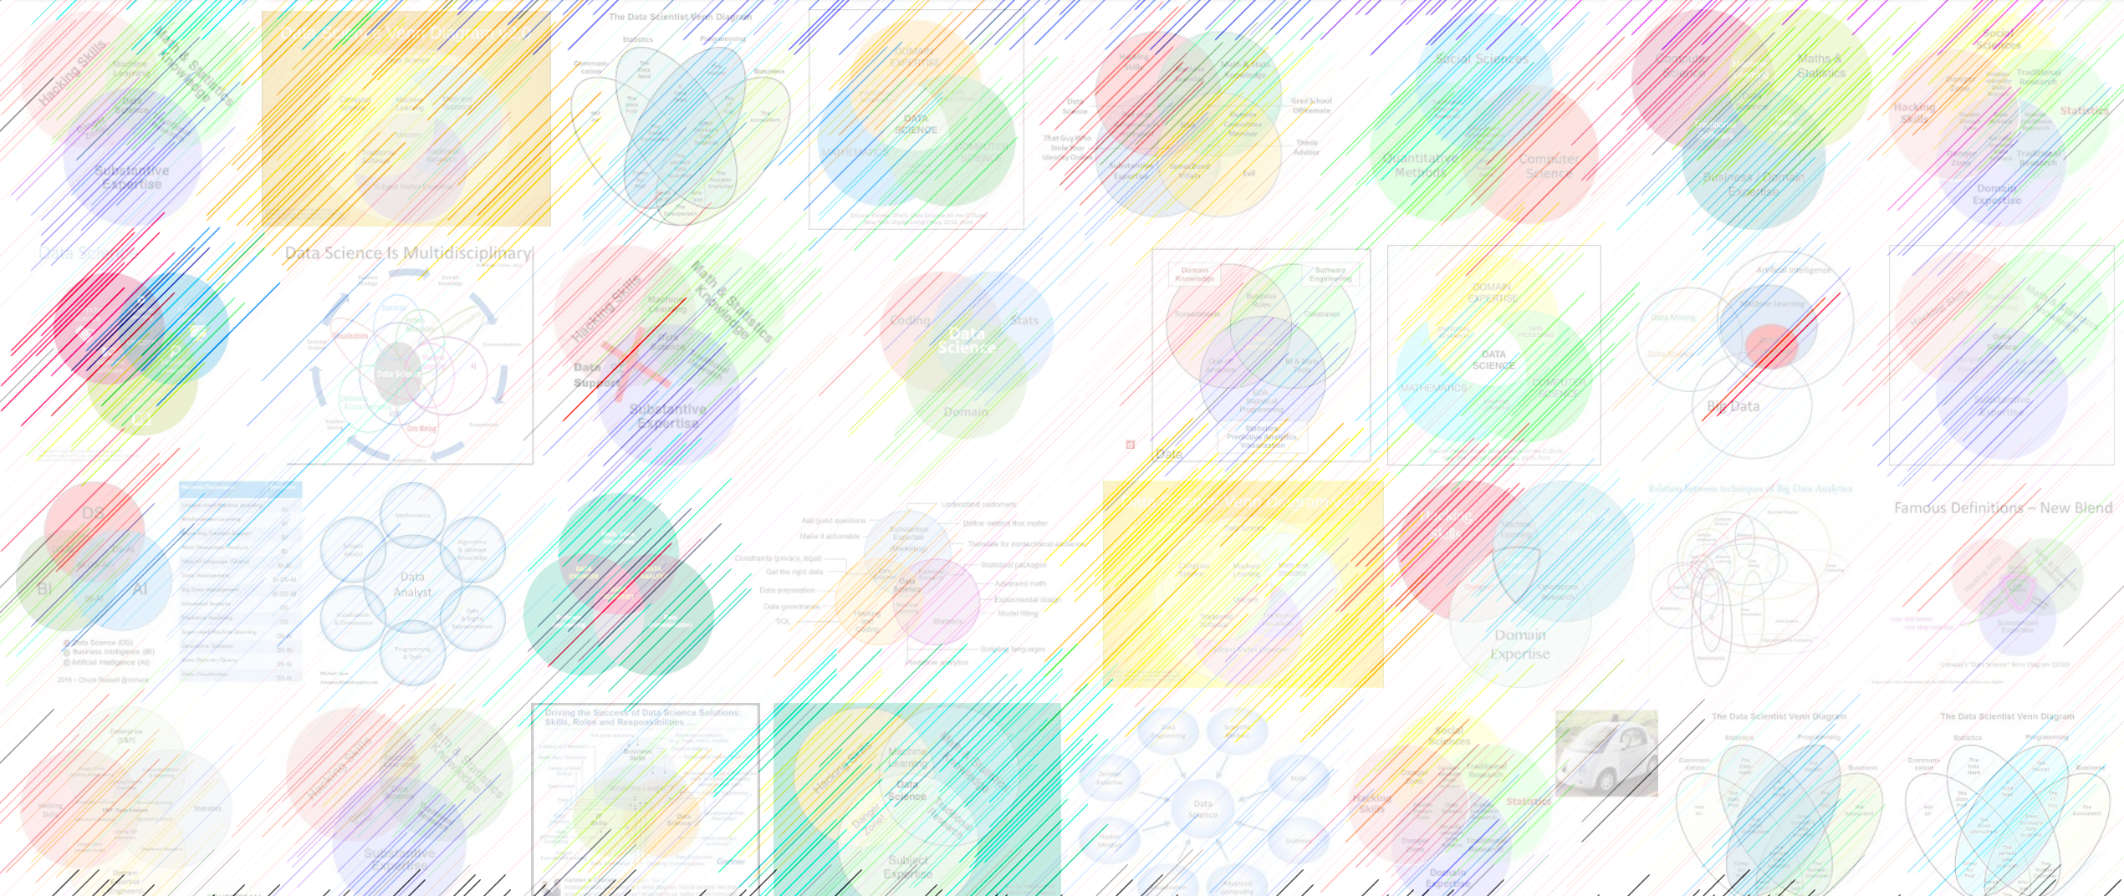

Cloud computing; motion-transfer deepfakes
William Trimble
Spring 2022

Slide 2

Who has had the “grumpy sysadmin” problem?

Slide 3
Who has had the “grumpy sysadmin” problem?
You’re not installing those unholy packages from the University of We-Don’t-Sanitize-Our-Inputs on my server.

Slide 4
Who has had the “grumpy sysadmin” problem?
You’re not installing those unholy packages from the University of We-Don’t-Sanitize-Our-Inputs on my server.
Install on your laptop?
Get some private environment on the server?
Get your own server?

Slide 5
First-order deepfake model
Aliaksandr Siarohin NeurIPS 2019
Define the model:
https://github.com/AliaksandrSiarohin/first-order-model/blob/master/config/vox-256.yaml
Parameters, equivalent to the CNN definition, that specify number and arrangement of parameters to be fit.

Slide 6
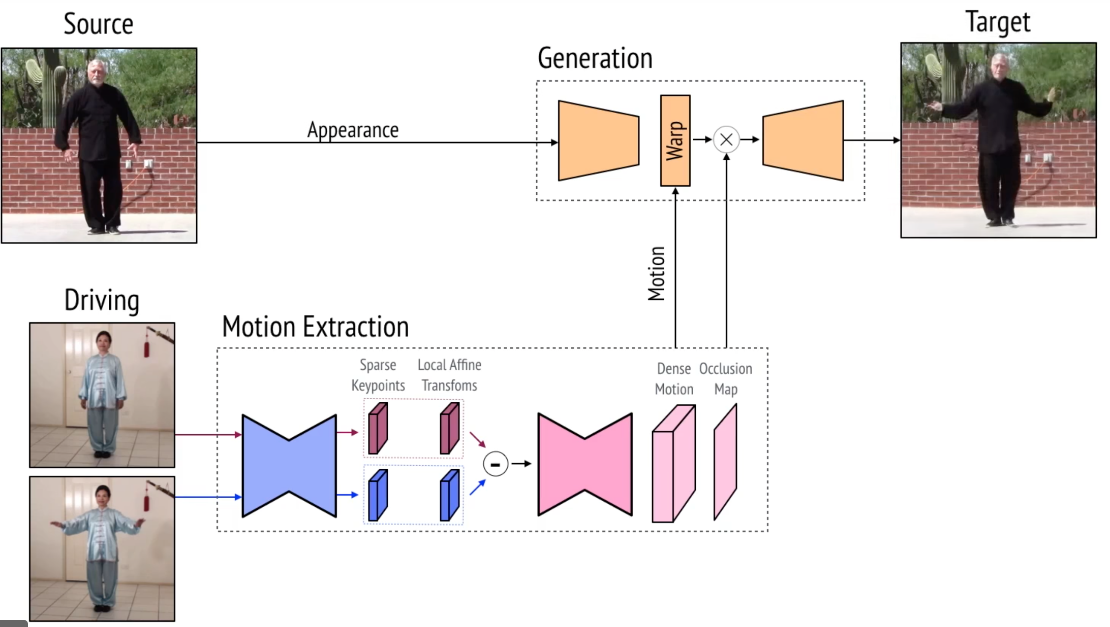

Slide 7
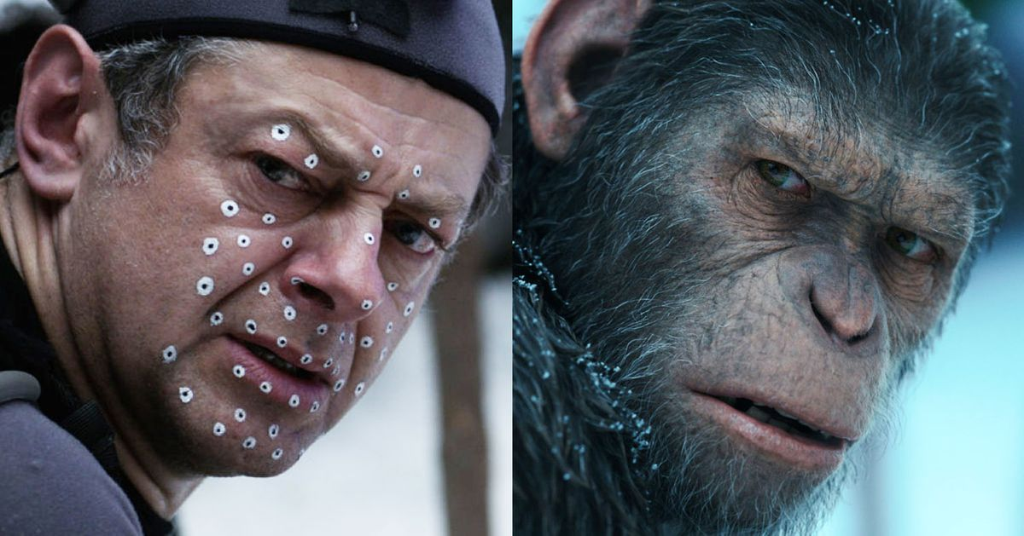
Dawn of the Planet of the Apes, 2014

Slide 8
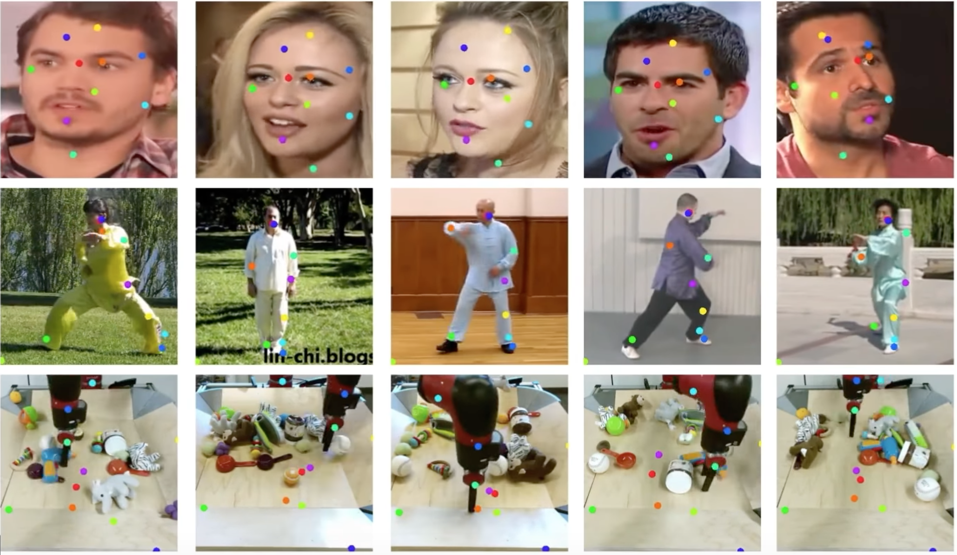

Slide 9
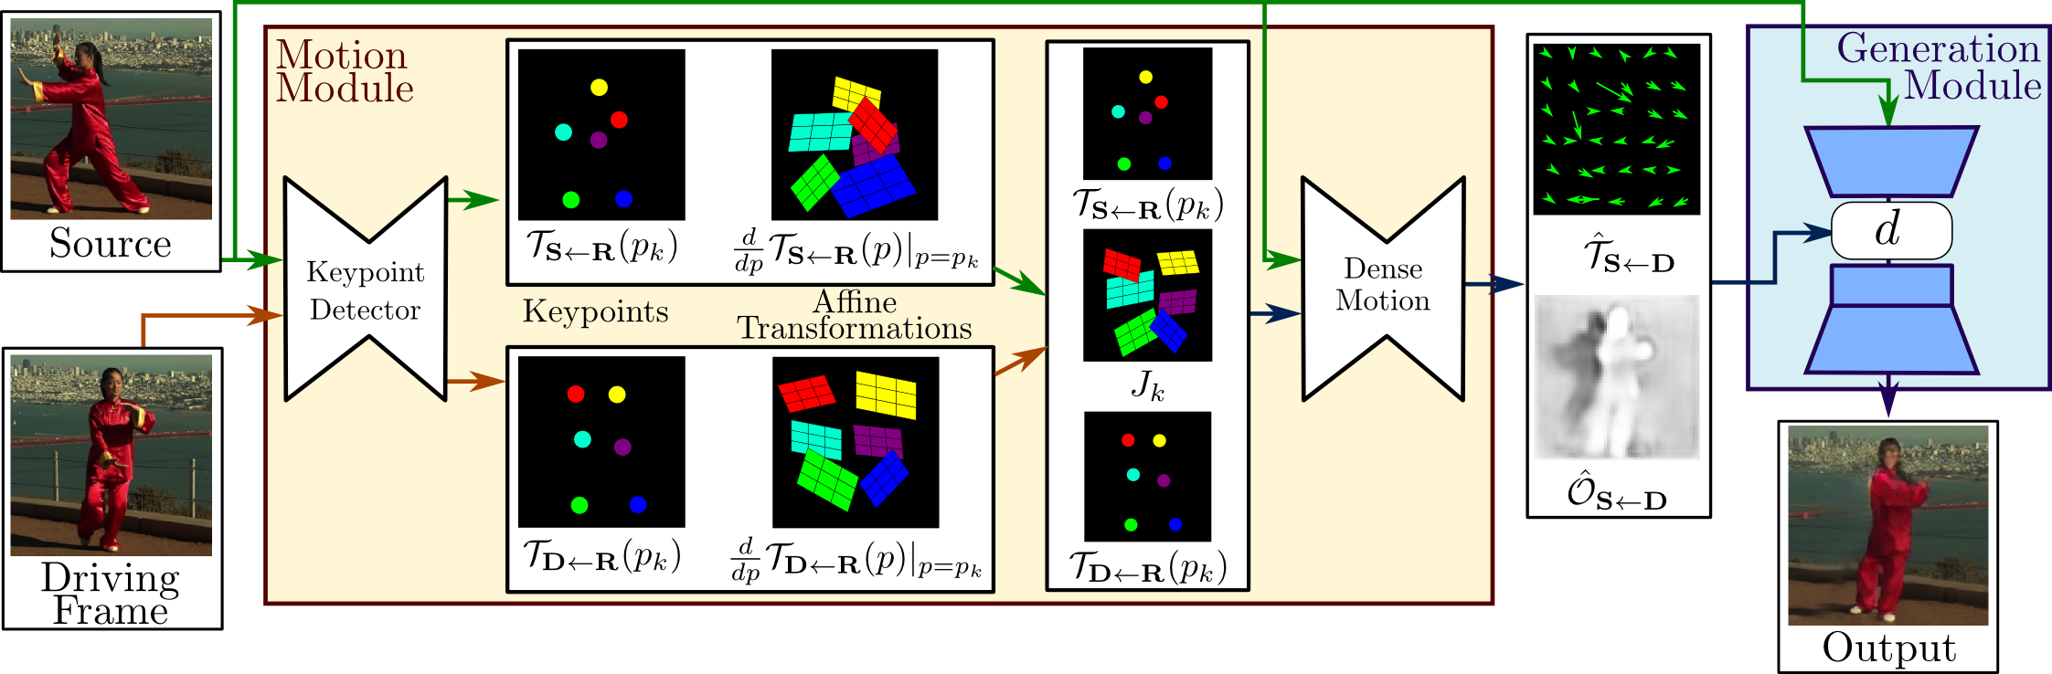
First-order deepfake model

Slide 10

First-order deepfake model
https://github.com/AliaksandrSiarohin/first-order-model
Deep neural network trained on how to distort one face into another.

Slide 11
My problem is too hard! What can I do?
Sometimes there is a flaw in the scope. You don’t really need to download the entirety of 20th century literature…
Sometimes there is a cool CS trick that makes an expensive problem 100x cheaper. (sparse representations, FFT, Burows-Wheeler transform, compression writ large)
Sometimes you can compute an approximate answer that gives you 90% of the answers for 9% of the resources. (randomized algorithms, database optimization)
Sometimes you just can’t do it without more resources.

Slide 12
What resources do I need?
Memory
Storage space
Network connection
How recently we run into “out of storage space” or “out of memory” problems?

Slide 13
What resources do I need?
Memory
Storage space
Network connection
Computing is not free, and these cool models pay nonzero amounts of rent.
The code is cheap, can be hosted for free.
The training data is probably encumbered and jealously guarded anyway.
The pretrained models are what our phones use for snapchat filters and videochat background suppression.

Slide 14



Computing has been commodified

Slide 15
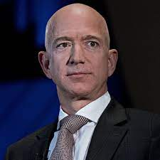
What is cloud computing?
https://aws.amazon.com/ec2/pricing/
You give them a public key, a credit card, and an order for a part of a server
They give you an IP address and control of a server
“EC2 usage are billed on one second increments, with a minimum of 60 seconds.”

Slide 16
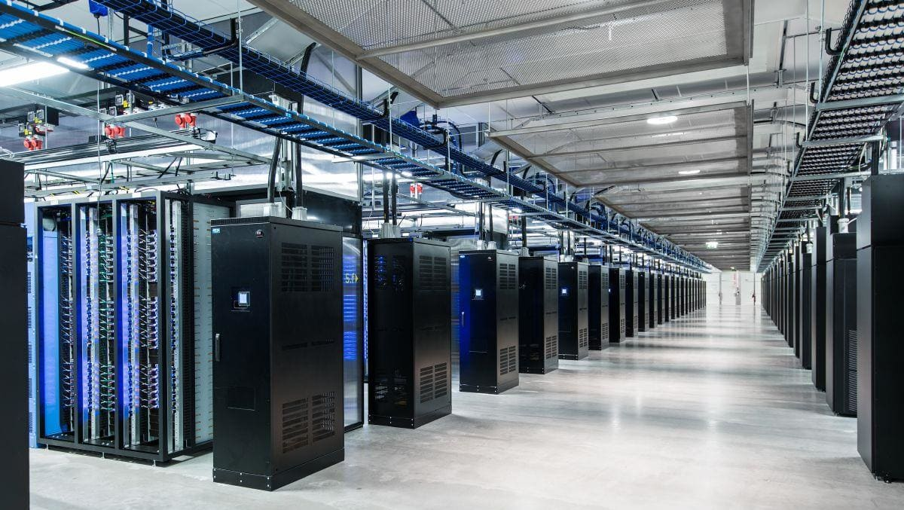

Slide 17
EC2 pricing
Instance name | On-demand hourly rate | Vcpu | Memory | Storage | Network performance
a1.medium | $0.0255 | 1 | 2 GiB | EBS Only | Up to 10 Gigabit
a1.large | $0.051 | 2 | 4 GiB | EBS Only | Up to 10 Gigabit
a1.xlarge | $0.102 | 4 | 8 GiB | EBS Only | Up to 10 Gigabit
a1.2xlarge | $0.204 | 8 | 16 GiB | EBS Only | Up to 10 Gigabit
a1.4xlarge | $0.408 | 16 | 32 GiB | EBS Only | Up to 10 Gigabit
https://aws.amazon.com/ec2/pricing/on-demand/

Slide 18
Yeah, but what does it mean for me?
When you run out of some essential resource you need for analysis, you ask your sponsor for funding to rent computers to solve your problem.
You have to learn to steward ephemeral compute resources in exchange for not owning the depreciation and maintenance;
Tending cloud servers has a different feedback cycle / pace from other tasks.

Slide 19
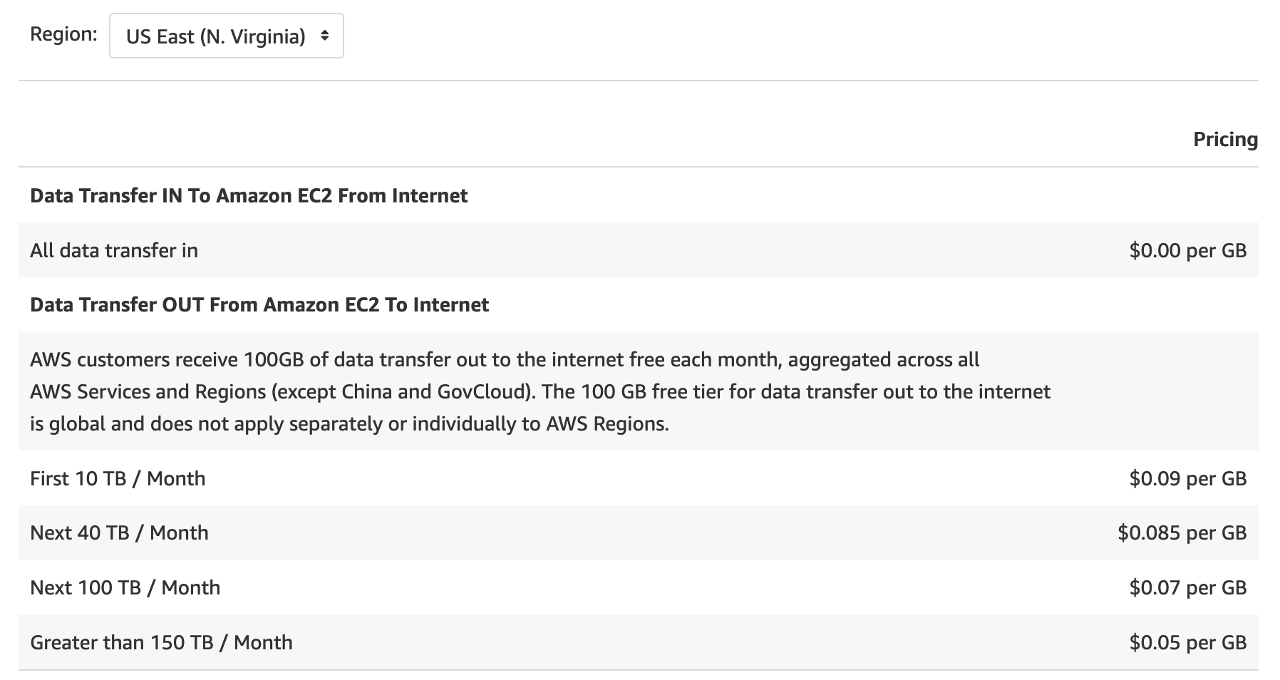

Slide 20
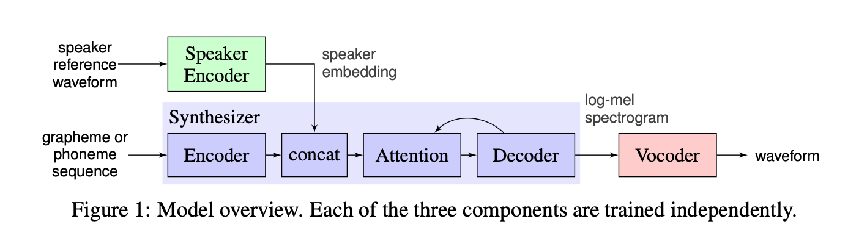
Real-time voice cloning
https://colab.research.google.com/github/tugstugi/dl-colab-notebooks/blob/master/notebooks/RealTimeVoiceCloning.ipynb

Slide 21
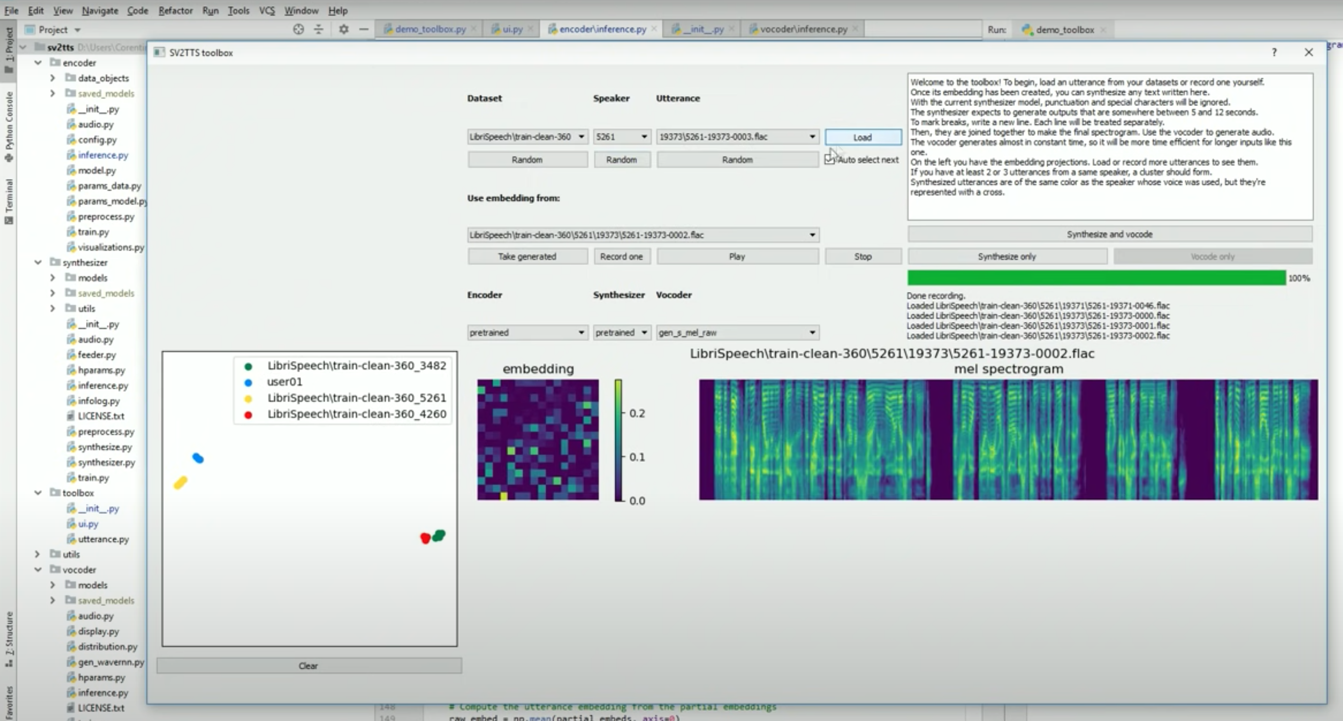
https://github.com/CorentinJ/Real-Time-Voice-Cloning

